Slide 1
Informed Search
HW2 is due Wednesday by 11:59pm.
If you need an extension, you must request it 24 hours in advance to avoid a late penalty.
Notes:
TODO - Consistent Heuristics
Read AIMA 3.1-3.6.
Some materials will not be covered in lecture, but will be on the exam.

Slide 2
Review: Search problem definition
States: a set S
An initial state s_{i}∈S
Actions: a set A
∀ s Actions(s) = the set of actions that can be executed in s, that are applicable in s.
Transition Model: ∀ s∀ a∈Actions(s) Result(s, a) → s_{r}
s_{r} is called a successor of s
{s_{i} }∪ Successors(s_{i} )* = state space
Path cost (Performance Measure): Must be additive
e.g. sum of distances, number of actions executed, …
c(x,a,y) is the step cost, assumed ≥ 0
(where action a goes from state x to state y)
Goal test: Goal(s)
Can be implicit, e.g. checkmate(s)
s is a goal state if Goal(s) is true

Slide 3
Review: Useful Concepts
State space: the set of all states reachable from the initial state by any sequence of actions
When several operators can apply to each state, this gets large very quickly
Might be a proper subset of the set of configurations
Path: a sequence of actions leading from one state s_{j} to another state s_{k}
Frontier: those states that are available for expanding (for applying legal actions to)
Solution: a path from the initial state s_{i} to a state s_{g} that satisfies the goal test
Notes:
.

Slide 4
Onderon
71
Polis Massa
Coruscant
87
151
Iridonia
75
Alderaan
140
Starkiller Base
92
Endor
99
118
Vandor-1
80
Ryloth
Tatooine
Lotho Minor
142
111
Naboo
211
97
70
98
Mandalore
85
Hoth
146
101
Bespin
75
138
86
Kessel
Dagobah
120
90
Fondor
Zygerria
Geonosis
Notes:
Alderaan Coruscant 75
Alderaan Starkiller Base 140
Alderaan Tatooine 118
Coruscant Onderon 71
Onderon Starkiller Base 151
Tatooine Lotho Minor 111
Lotho Minor Mandalore 70
Mandalore Dagobah 75
Dagobah Zygerria 120
Zygerria Ryloth 146
Zygerria Naboo 138
Ryloth Naboo 97
Ryloth Starkiller Base 80
Starkiller Base Endor 99
Kessel Naboo 101
Kessel Endor 211
Kessel Geonosis 90
Kessel Bespin 85
Bespin Hoth 98
Hot Fondor 86
Vandor-1 Bespin 142
Iridonia Vandor-1 92
Polis Massa Iridonia 87

Slide 5
Onderon
71
Coruscant
Polis Massa
87
151
Iridonia
75
Alderaan
140
Starkiller Base
Endor
92
99
118
80
Vandor-1
Ryloth
Tatooine
111
142
Naboo
211
Lotho Minor
97
98
70
Hoth
Mandalore
101
85
146
Bespin
138
86
75
Kessel
120
Dagobah
90
Geonosis
Zygerria
Fondor

Slide 6
Onderon
71
Coruscant
Polis Massa
151
87
Iridonia
75
140
Starkiller Base
Endor
Alderaan
92
99
118
80
Vandor-1
Ryloth
Tatooine
111
142
Naboo
211
Lotho Minor
97
98
70
146
101
85
Hoth
Mandalore
Bespin
138
86
75
Kessel
Dagobah
90
120
Geonosis
Zygerria
Fondor

Slide 7
Onderon
Coruscant
Polis Massa
Iridonia
Alderaan
Starkiller Base
Endor
Vandor-1
Ryloth
Tatooine
Naboo
Lotho Minor
Hoth
Mandalore
Bespin
Kessel
Dagobah
Geonosis
Zygerria
Fondor

Slide 8
Onderon
Coruscant
Polis Massa
Iridonia
Starkiller Base
Alderaan
Endor
Vandor-1
Tatooine
Ryloth
Naboo
Lotho Minor
Hoth
Mandalore
Bespin
Kessel
Dagobah
Geonosis
Fondor
Zygerria

Slide 9
Search Tree
Root node = start state
Alderaan
Expanded nodes
Starkiller Base
Tatooine
Coruscant
Alderaan
Onderon
Endor
Ryloth
Alderaan
Lotho Minor
Alderaan
Starkiller Base
Frontier
Choose leaf node from frontier for expansion according to to the search strategy
Determines the search process

Slide 10
Review: Search Strategies
Strategy = order of tree expansion
Implemented by different queue structures (LIFO, FIFO, priority)
Dimensions for evaluation
Completeness- always find the solution?
Optimality - finds a least cost solution (lowest path cost) first?
Time complexity - # of nodes generated (worst case)
Space complexity - # of nodes simultaneously in memory (worst case)
Time/space complexity variables
b, maximum branching factor of search tree
d, depth of the shallowest goal node
m, maximum length of any path in the state space (potentially ∞)
CIS 521 | 7
Notes:
.

Slide 11
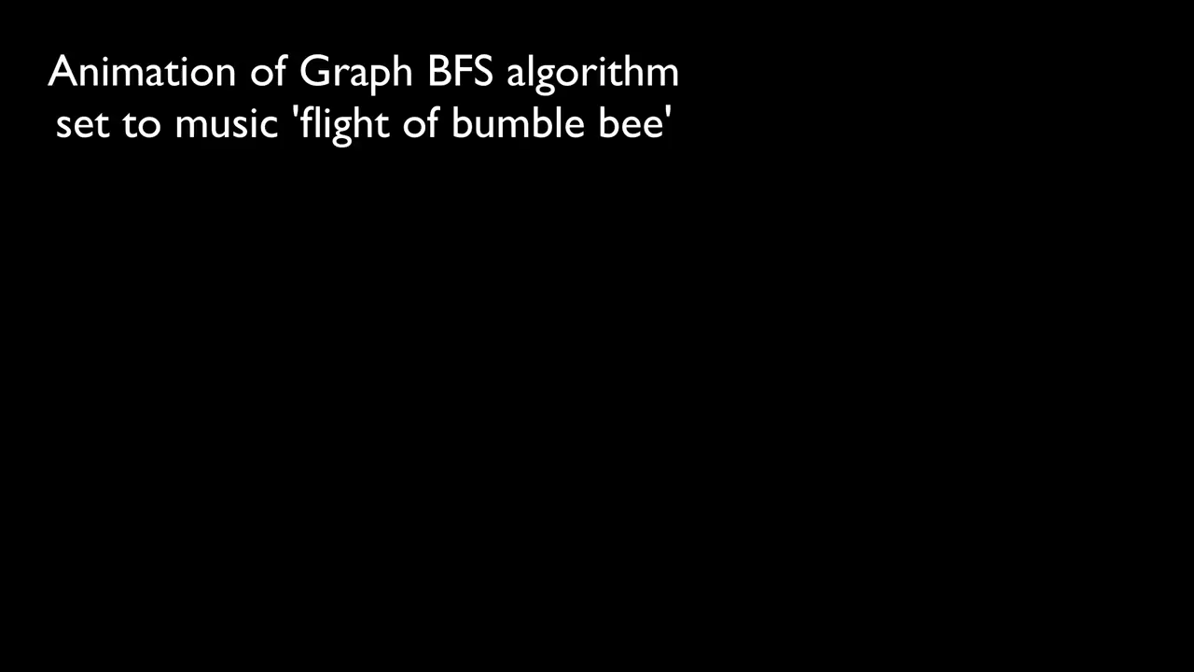

Breadth first search
https://youtu.be/x-VTfcmrLEQ
Notes:
.

Slide 12
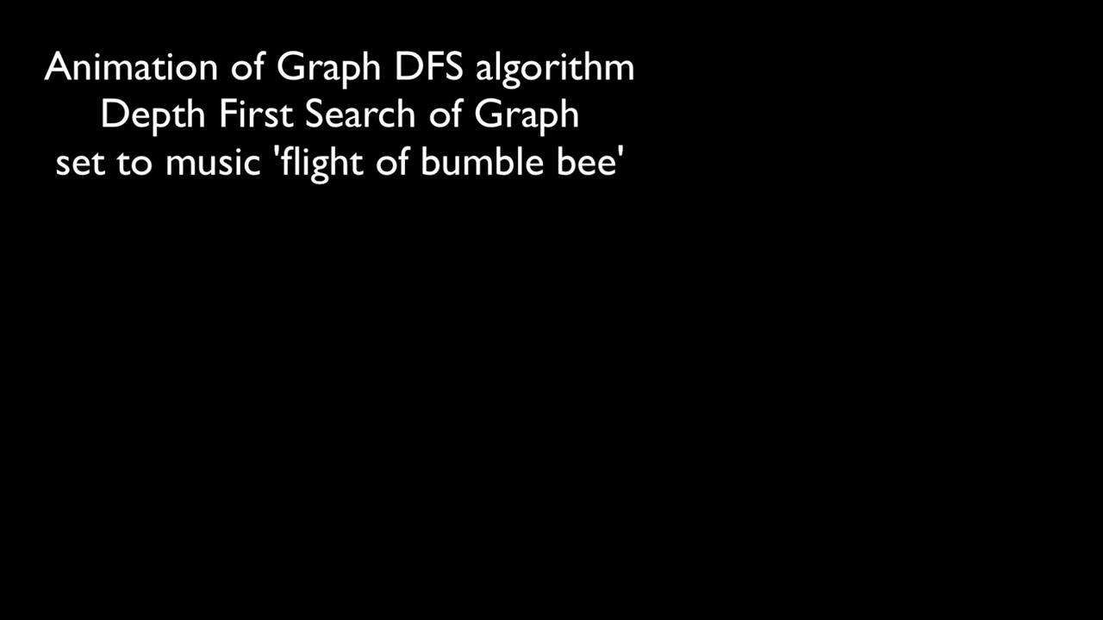
https://youtu.be/NUgMa5coCoE
Notes:
.

Slide 13
“Uniform Cost” Search
“In computer science, uniform-cost search (UCS) is a tree search algorithm used for traversing or searching a weighted tree, tree structure, or graph.” - Wikipedia
Notes:
.

Slide 14
Motivation: Map Navigation Problems
All our search methods so far assume step-cost = 1
This is only true for some problems
Notes:
.

Slide 15
g(N): the path cost function
Our assumption so far: All moves equal in cost
Cost = # of nodes in path-1
g(N) = depth(N) in the search tree
More general: Assigning a (potentially) unique cost to each step
N₀, N₁, N₂, N₃ = nodes visited on path p from N₀ to N₃
C(i,j): Cost of going from N_{i} to N_{j}
If N₀ the root of the search tree, g(N3)=C(0,1)+C(1,2)+C(2,3)
Notes:
.

Slide 16
Uniform-cost search (UCS)
Extension of BF-search:
Expand node with lowest path cost
Implementation:
frontier = priority queue ordered by g(n)
Subtle but significant difference from BFS:
Tests if a node is a goal state when it is selected for expansion, not when it is added to the frontier.
Updates a node on the frontier if a better path to the same state is found.
So always enqueues a node before checking whether it is a goal.
WHY???
Notes:
.

Slide 17

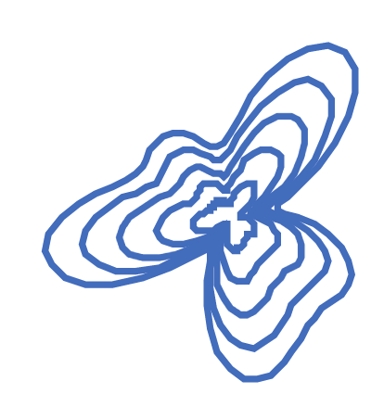
Shape of Search
Breadth First Search explores equally in all directions. Its frontier is implemented as a FIFO queue. This results in smooth contours or “plys”.
Uniform Cost Search lets us prioritize which paths to explore. Instead of exploring all possible paths equally, it favors lower cost paths. Its frontier is a priority queue. This results in “cost contours”.
Notes:
.

Slide 18

This may remind you of something…
Which algorithm from your algorithms class does Uniform Cost Search remind you of?
PollEv.com​/ccb
Notes:
https://www.polleverywhere.com/activities Graph search algorithms are fundamental topics in computer science, and several of them are typically covered in core algorithms courses. Here are some of the most commonly presented graph search algorithms:
Depth-First Search (DFS): This algorithm explores as far as possible along each branch before backtracking. It uses a stack (either explicitly or implicitly through recursion) to keep track of vertices to explore.
Breadth-First Search (BFS): This algorithm explores the neighbor vertices at the present depth before moving on to vertices at the next depth level. It uses a queue to keep track of the vertices to explore.
Dijkstra's Algorithm: This is a single-source shortest path algorithm for weighted graphs. It finds the shortest path from a given vertex to every other vertex in the graph. The graph must not contain any negative weight edges for this algorithm to work correctly.
Bellman-Ford Algorithm: Another single-source shortest path algorithm, which can handle graphs with negative weight edges. However, it can't handle graphs with negative weight cycles.
Floyd-Warshall Algorithm: This is an all-pairs shortest path algorithm. It finds the shortest paths between all pairs of vertices in a weighted graph.
A Search Algorithm:* This is an informed search algorithm used in path-finding and graph traversal. It uses a heuristic to estimate the cost to reach the goal, making it more efficient than uninformed search algorithms in many cases.
Topological Sort: This is a linear ordering of the vertices of a directed acyclic graph (DAG) such that for every directed edge UVUV, vertex UU comes before VV in the ordering. It's often used in scheduling problems.
Prim's Algorithm: A greedy algorithm used for finding the minimum spanning tree of a weighted undirected graph.
Kruskal's Algorithm: Another algorithm for finding the minimum spanning tree of a weighted undirected graph.
Borůvka's Algorithm (Sollin's Algorithm): Also used for finding the minimum spanning tree of a graph.

Slide 19
Uniform Cost Search (UCS) vs. Dijkstra's algorithm
Foundational Concepts:
Dijkstra's: Shortest path from initial to all vertices in a weighted graph.
UCS: AI's pathfinding. Shortest path from initial state to a goal state.
Similarities:
Use of Priority Queue to pick lowest cost node.
Greedy Nature: Always choose optimal local solution.
Both operate on a weighted graph.
Guarantee Optimality for non-negative weights.
Differences:
Objective: UCS targets specific goal node; Dijkstra's finds paths to all nodes.
Termination: UCS stops at goal; Dijkstra's stops after all nodes have been reached.
Relation:
UCS is a "targeted" Dijkstra’s: it seeks a path to a specific node, not all nodes.
Notes:
1. Foundational Concepts:
UCS: It is a tree/graph search algorithm used in AI for pathfinding and graph traversal. The goal is to find the path to a goal state with the smallest cumulative cost.
Dijkstra's Algorithm: It is a graph traversal algorithm used to find the shortest path from a source vertex to all vertices in a weighted graph.
2. Similarities:
Priority Queue: Both algorithms use a priority queue (or a similar data structure) to determine which node to explore next. The node with the lowest cumulative cost is always chosen first.
Greedy Nature: Both are greedy algorithms in the sense that they make the optimal choice at each step by picking the node with the least cost.
Optimality: Both algorithms guarantee to find an optimal solution if the edge weights (or costs) are non-negative.
3. Differences:
Objective:
UCS: The primary objective is to find a path to a specific goal node with the lowest cost.
Dijkstra's: The objective is to find the shortest path from a source node to all other nodes in the graph.
Termination:
UCS: It terminates once the goal node is dequeued from the priority queue.
Dijkstra's: It continues until all nodes in the graph have been visited.
4. Relating to Previous Knowledge:
If students are familiar with Dijkstra's algorithm, you can introduce UCS as a "targeted" version of Dijkstra's. While Dijkstra's computes paths to all nodes, UCS stops as soon as the goal node is found.
You can draw a parallel by showing that UCS can be seen as an application of Dijkstra's where we are only interested in a path to one specific node, rather than all nodes.
5. Practical Application & Visualization:
Consider doing a side-by-side comparison of the two algorithms using a graph with weighted edges. Visualize the order in which nodes are explored and how the priority queue changes over time for both algorithms.
Discuss applications: While Dijkstra's might be used in routing protocols to find shortest paths in networks, UCS might be used in games or robotics to find the shortest path to a goal.
6. Extensions & Variations:
Introduce the concept of heuristics and how it leads to the A* algorithm. A* is an informed search algorithm that combines the cost-to-come (from UCS) with a heuristic estimate of the cost-to-go, providing an efficient way to find the shortest path.
7. Discussion on Edge Cases & Assumptions:
Discuss the importance of non-negative weights. Both algorithms assume non-negative weights, and negative weights can lead to incorrect results. Delve into why this is the case and how other algorithms like Bellman-Ford can handle graphs with negative weights.
By drawing these parallels and discussing the nuances, students will not only see the connection between foundational algorithms and AI concepts but also appreciate the evolution and application of these ideas in diverse domains.

Slide 20
Onderon
Uniform Cost Search
71
Coruscant
Polis Massa
87
151
g(n)<300
Iridonia
75
Alderaan
140
Starkiller Base
Endor
92
99
g(n)<200
118
80
Vandor-1
Ryloth
Tatooine
111
142
Naboo
211
g(n)<100
Lotho Minor
97
98
70
Hoth
Mandalore
101
85
146
Bespin
138
WRONG
WAY!!!!
86
75
Kessel
120
Dagobah
90
Geonosis
Zygerria
Fondor

Slide 21
Onderon
Uniform Cost Search
71
Coruscant
Polis Massa
87
151
g(n)<300
Iridonia
75
Alderaan
140
Starkiller Base
Endor
92
99
g(n)<200
118
80
Vandor-1
Ryloth
Tatooine
111
142
Naboo
211
g(n)<100
Lotho Minor
97
98
70
Hoth
Mandalore
101
85
146
Bespin
138
WRONG
WAY!!!!
86
75
Kessel
120
Dagobah
90
Geonosis
Zygerria
Fondor

Slide 22
Onderon
71
Coruscant
Polis Massa
87
151
Iridonia
75
Alderaan
140
Starkiller Base
Endor
92
99
118
80
Vandor-1
Ryloth
Tatooine
111
142
Naboo
211
Lotho Minor
97
98
70
Hoth
Mandalore
101
85
146
Bespin
138
86
75
Kessel
120
Dagobah
90
Geonosis
Zygerria
Fondor

Slide 23
Onderon
Onderon
Uniform Cost Search
71
Coruscant
Polis Massa
87
Iridonia
151
Iridonia
151
g(n)<300
75
Alderaan
Alderaan
Starkiller Base
140
Starkiller Base
140
Endor
Endor
92
92
99
99
g(n)<200
118
Vandor-1
80
Vandor-1
80
Ryloth
Ryloth
Ryloth
Tatooine
142
111
Naboo
g(n)<100
142
Naboo
Naboo
211
211
97
Lotho Minor
97
98
98
70
Hoth
Hoth
85
Hoth
101
85
Mandalore
146
101
146
Bespin
Bespin
86
138
WRONG
WAY!!!!
86
138
Kessel
75
Kessel
120
120
Dagobah
Dagobah
90
90
Geonosis
Geonosis
Zygerria
Zygerria
Zygerria
Fondor
Fondor

Slide 24
A better idea than UCS…
Node expansion based on an estimate which includes distance to the goal
General approach of informed search:
Best-first search: node selected for expansion based on an evaluation function f(n)
f(n) includes estimate of distance to goal (new idea!)
Implementation: Sort our frontier queue by this new f(n).
Instances of best-first search:
greedy search
A* search
Notes:
.

Slide 25
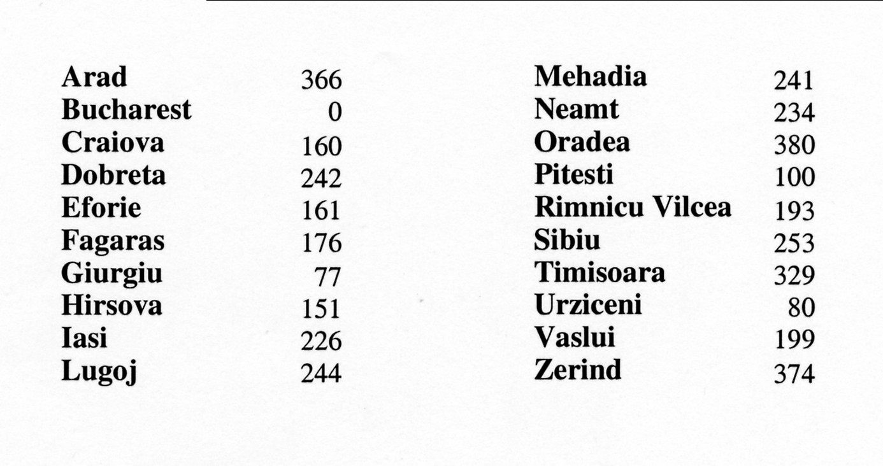
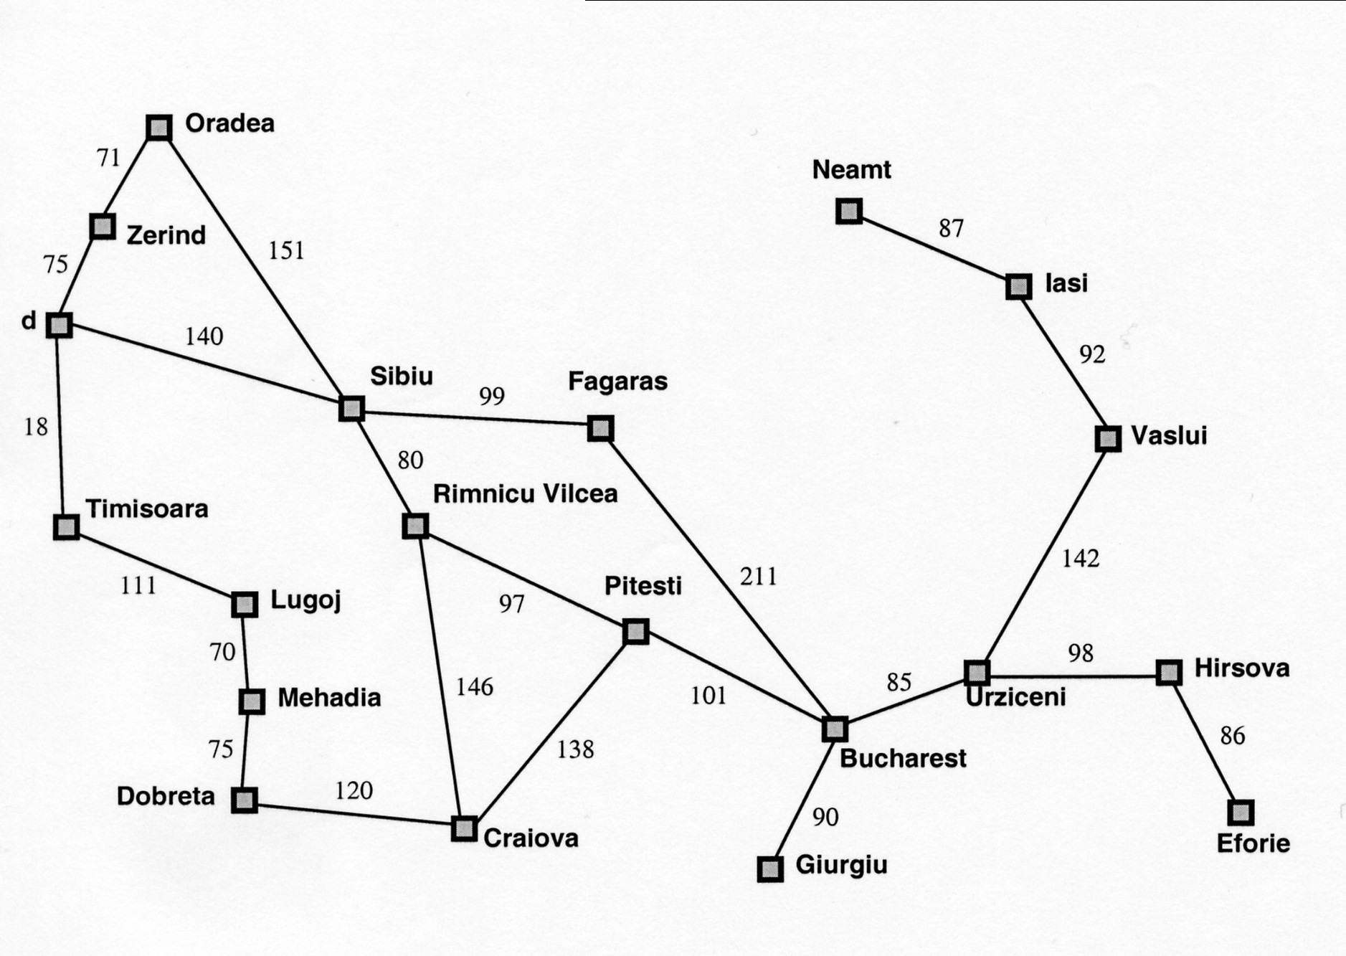
Simple, useful estimate heuristic: straight-line distances
Arad
118
Notes:
.

Slide 26
Onderon
Simple, useful estimate heuristic: straight-line distances
Alderaan | 366 |  | Mandalore | 241
Kessel | 0 |  | Polis Massa | 234
Zygerria | 160 |  | Onderon | 380
Dagobah | 242 |  | Naboo | 100
Fondor | 161 |  | Ryloth | 193
Endor | 176 |  | Starkiller Base | 253
Geonosis | 77 |  | Tatooine | 329
Hoth | 151 |  | Bespin | 80
Iridonia | 226 |  | Vandor-1 | 199
Lotho Minor | 244 |  | Coruscant | 374
71
Polis Massa
Coruscant
87
151
Iridonia
75
Alderaan
140
Starkiller Base
92
Endor
99
118
Vandor-1
80
Ryloth
Tatooine
Lotho Minor
142
111
Naboo
211
97
70
98
Mandalore
85
Hoth
146
101
Bespin
75
138
86
Kessel
Dagobah
120
90
Fondor
Zygerria
Geonosis

Slide 27

Heuristic (estimate) functions
[dictionary]“A rule of thumb, simplification, or educated guess that reduces or limits the search for solutions in domains that are difficult and poorly understood.”
Heuristic knowledge is useful, but not necessarily correct.
Heuristic algorithms use heuristic knowledge to solve a problem.
A heuristic function h(n) takes a state n and returns an estimate of the distance from n to the goal.
Heureka! ---Archimedes
Notes:
(graphic: http://hyperbolegames.com/2014/10/20/eureka-moments/)

Slide 28
Greedy Best-First Search
First attempt at integrating heuristic knowledge
Notes:
Hello everyone, today we're going to discuss our first informed search algorithm called Best-First Search. This lecture will serve as an introduction to integrating heuristic knowledge into our search algorithms.
We'll start by discussing the basic idea behind Best-First Search and how it differs from the uninformed search strategies we've covered so far. Then, we'll dive into a specific variant of Best-First Search called Greedy Best-First Search, which will be our first attempt at incorporating heuristics.
Throughout the lecture, we'll use examples to illustrate how Greedy Best-First Search works and analyze its properties, including optimality and completeness. By the end of this lecture, you should have a solid understanding of how heuristics can guide our search algorithms and the trade-offs involved.

Slide 29
Best-first search
Basic idea:
Select node for expansion with minimal evaluation function f(n)
where f(n) is some function that includes estimate heuristic h(n) of the remaining distance to goal
Implement using priority queue
Exactly UCS with f(n) replacing g(n)
Notes:
As mentioned, Greedy Best-First Search is our first attempt at integrating heuristic knowledge into our search algorithms. The basic idea behind Best-First Search is to select the node for expansion that has the minimal evaluation function f(n), where f(n) is some function that includes an estimate heuristic h(n) of the remaining distance to the goal.
To implement Best-First Search, we use a priority queue, similar to how we implemented Uniform Cost Search. The key difference is that instead of using g(n), which represents the cost to reach node n, we use the evaluation function f(n).
In the specific case of Greedy Best-First Search, we define f(n) to be equal to the heuristic function h(n). This means that Greedy Best-First Search will always expand the node that is estimated to be closest to the goal, completely ignoring the cost to reach that node.

Slide 30
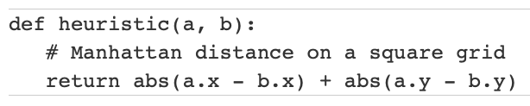
Greedy best-first search: f(n) = h(n)
Expands the node that is estimated to be closest to goal
Completely ignores g(n): the cost to get to n
In our Romanian map, h(n) = h_{SLD}(n) = straight-line distance from n to Bucharest
In a grid, the heuristic distance can be calculated using the “Manhattan distance”:
Notes:
In the context of our Romanian map example, we might use the straight-line distance from a node to Bucharest as our heuristic function h(n). In a grid-based environment, we can calculate the heuristic distance using the Manhattan distance.
It's important to note that by focusing solely on the heuristic function and ignoring the actual cost to reach a node, Greedy Best-First Search may not always find the optimal path. In the next few slides, we'll explore some examples to better understand how Greedy Best-First Search works and analyze its properties. When we're searching in a grid-based environment, we can use the Manhattan distance as our heuristic function h(n) to estimate the distance between two points. The Manhattan distance is named after the grid-like layout of streets in Manhattan, where you can only travel along the horizontal and vertical directions.
Let's take a look at the code for calculating the Manhattan distance:
python
Copy
def heuristic(a, b): # Manhattan distance on a square grid return abs(a.x - b.x) + abs(a.y - b.y)
Here, a and b represent two points on the grid, and we want to estimate the distance between them. Each point has an xand y coordinate.
The formula abs(a.x - b.x) + abs(a.y - b.y) calculates the absolute difference between the x-coordinates and the absolute difference between the y-coordinates of the two points, and then adds them together.
Imagine you're walking on a grid from point a to point b. The abs(a.x - b.x) part of the formula represents the number of horizontal steps you need to take, while abs(a.y - b.y) represents the number of vertical steps. By adding these together, we get the total number of steps required to reach point b from point a, assuming we can only move horizontally or vertically.
In the context of Greedy Best-First Search, we use the Manhattan distance as our heuristic function h(n) to estimate the distance from a node n to the goal node. By always expanding the node with the lowest h(n) value, Greedy Best-First Search tries to move closer to the goal with each step, even though it might not always find the optimal path.

Slide 31
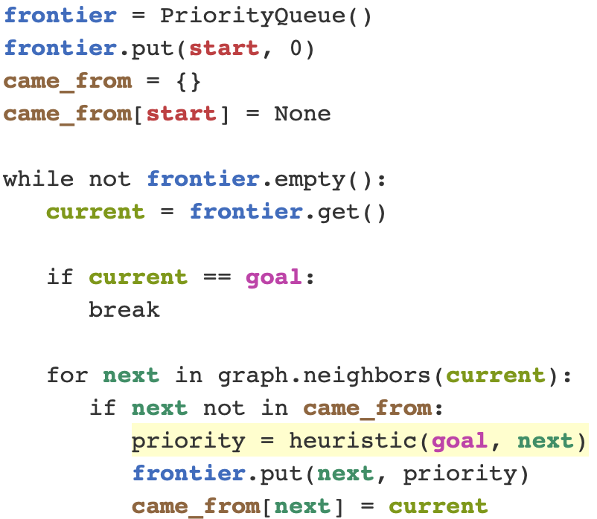
Greedy best-first search
Code from Amit Patel of Red Blob Games
This is not the solution to the HW assignment.
Notes:
Now that we understand the basic idea behind Greedy Best-First Search and how the Manhattan distance heuristic works, let's take a look at how we can implement the algorithm in Python.
Let's break this down step-by-step:
We start by initializing a priority queue called frontier and adding the start node with a priority of 0.
We also create a dictionary called came_from to keep track of the path we've taken. We set the value of start to None since it's the starting point and has no previous node.
We enter a loop that continues as long as the frontier is not empty.
Inside the loop, we get the node with the lowest priority from the frontier using frontier.get() and assign it to current.
If current is equal to the goal node, we break out of the loop because we've found a path to the goal.
If current is not the goal, we loop through each of its neighbors using graph.neighbors(current).
For each next neighbor, we check if it's not in the came_from dictionary, meaning we haven't visited it before.
If next is unvisited, we calculate its priority using the heuristic function heuristic(goal, next), which estimates the distance from next to the goal.
We add next to the frontier with its calculated priority and update the came_from dictionary to indicate that we reached next from current.
The loop continues until we either find the goal or exhaust all possible paths.
By using a priority queue and always selecting the node with the lowest heuristic value, Greedy Best-First Search tries to expand the most promising nodes first. However, as we discussed earlier, this doesn't guarantee that it will find the optimal path.
It's important to note that this code is not a complete solution to the homework assignment, but rather a demonstration of how Greedy Best-First Search can be implemented in Python.

Slide 32
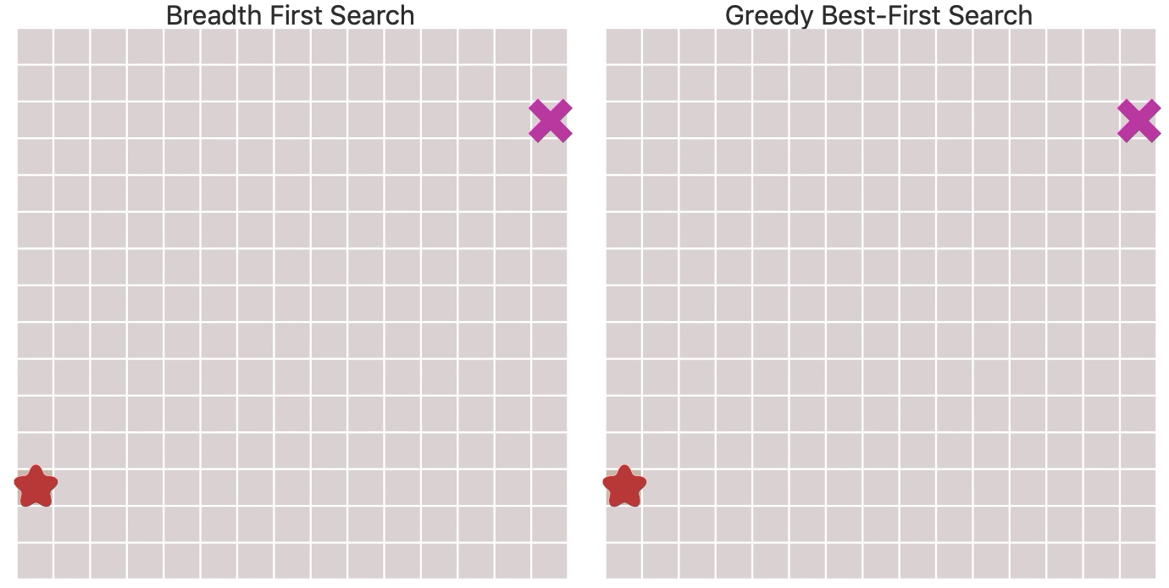
BFS v. Greedy Best-First Search
https://www.redblobgames.com/pathfinding/a-star/introduction.html
Notes:
. Greedy Best-First Search uses a heuristic function (in this case, the Manhattan distance) to estimate the distance from each node to the goal. It always expands the node that appears to be closest to the goal, based on the heuristic.
In the animation, we can see Greedy Best-First Search quickly moving towards the goal node, seemingly ignoring the other directions. It expands nodes that are estimated to be closer to the goal (darker purple squares), leaving many unexplored nodes (light gray squares) behind.
While Greedy Best-First Search reaches the goal faster than BFS in this instance, it's important to note that it does not guarantee finding the shortest path. In fact, we can see that the path found by Greedy Best-First Search (darker purple squares) is longer than the shortest path found by BFS.
This comparison highlights the key differences between uninformed search (like BFS) and informed search (like Greedy Best-First Search). BFS systematically explores the search space and guarantees finding the shortest path, but it can be inefficient in large search spaces. Greedy Best-First Search, on the other hand, uses a heuristic to guide its search, which can lead to faster solutions but doesn't guarantee optimality.
In the next slide, we'll explore the properties of Greedy Best-First Search in more detail, including its optimality and completeness.

Slide 33
Greedy best-first search example
Alderaan
Initial State: Alderaan Goal State: Kessel
Starkiller Base
Tatooine
Coruscant
Alderaan
Onderon
Endor
Ryloth
Alderaan
Lotho Minor
Alderaan
Starkiller Base
Frontier queue:
Planet | SLD |  | Planet | SLD
Alderaan | 366 |  | Lotho Minor | 244
Bespin | 80 |  | Mandalore | 241
Coruscant | 374 |  | Naboo | 100
Dagobah | 242 |  | Onderon | 380
Endor | 176 |  | Polis Massa | 234
Fondor | 161 |  | Ryloth | 193
Geonosis | 77 |  | Starkiller Base | 253
Hoth | 151 |  | Tatooine | 329
Iridonia | 226 |  | Vandor-1 | 199
Kessel | 0 |  | Zygerria | 160
Alderon 266

Slide 34
Greedy best-first search example
Alderaan
Initial State: Alderaan Goal State: Kessel
Frontier queue:
Planet | SLD |  | Planet | SLD
Alderaan | 366 |  | Lotho Minor | 244
Bespin | 80 |  | Mandalore | 241
Coruscant | 374 |  | Naboo | 100
Dagobah | 242 |  | Onderon | 380
Endor | 176 |  | Polis Massa | 234
Fondor | 161 |  | Ryloth | 193
Geonosis | 77 |  | Starkiller Base | 253
Hoth | 151 |  | Tatooine | 329
Iridonia | 226 |  | Vandor-1 | 199
Kessel | 0 |  | Zygerria | 160
Alderon 366
Notes:
Let's walk through the Greedy Best-First Search example step-by-step using the Star Wars planet navigation problem (which is my re-themed version of the Romanian map navigation task from the textbook – all the distances are the same, and I’ve tried to keep the planet names to the same as the first letter of the Romanian cities).
We start at the initial state, Alderaan, with the goal of reaching Kessel. The frontier queue initially contains only Alderaan with a straight-line distance (SLD) to our goal state of Kessel of 366. The SLD serves as our heuristic function, estimating the distance from each planet to the goal. The table in the bottom righthand corner contains all of the h(n) values. Given a planet n, what’s the SLD to Kessel?

Slide 35
Greedy best-first search example
Alderaan
Initial State: Alderaan Goal State: Kessel
Starkiller Base
Tatooine
Coruscant
Frontier queue:
Planet | SLD |  | Planet | SLD
Alderaan | 366 |  | Lotho Minor | 244
Bespin | 80 |  | Mandalore | 241
Coruscant | 374 |  | Naboo | 100
Dagobah | 242 |  | Onderon | 380
Endor | 176 |  | Polis Massa | 234
Fondor | 161 |  | Ryloth | 193
Geonosis | 77 |  | Starkiller Base | 253
Hoth | 151 |  | Tatooine | 329
Iridonia | 226 |  | Vandor-1 | 199
Kessel | 0 |  | Zygerria | 160
Starkiller Base 253
Tatooine 329
Coruscant 374
Notes:
From Alderaan, we expand to its neighboring planets: Starkiller Base, Tatooine, and Coruscant. These planets are added to the frontier queue and sorted based on their SLD to Kessel. Starkiller Base has the lowest SLD of 253, so it will be expanded next.

Slide 36
Greedy best-first search example
Alderaan
Initial State: Alderaan Goal State: Kessel
Starkiller Base
Tatooine
Coruscant
Alderaan
Onderon
Endor
Ryloth
Frontier queue:
Planet | SLD |  | Planet | SLD
Alderaan | 366 |  | Lotho Minor | 244
Bespin | 80 |  | Mandalore | 241
Coruscant | 374 |  | Naboo | 100
Dagobah | 242 |  | Onderon | 380
Endor | 176 |  | Polis Massa | 234
Fondor | 161 |  | Ryloth | 193
Geonosis | 77 |  | Starkiller Base | 253
Hoth | 151 |  | Tatooine | 329
Iridonia | 226 |  | Vandor-1 | 199
Kessel | 0 |  | Zygerria | 160
Are we doing graph search or tree search?
Tatooine 329
Coruscant 374
Alderaan 366
Onderon 380
Endor 176
Ryloth 193
Notes:
We expand Starkiller Base and add its neighbors to the frontier queue: Alderaan, Onderon, Endor, and Ryloth.
Are we doing graph search or tree search? here? You can pause the video and think about it for a second. In graph search, we keep track of visited nodes to avoid revisiting them, while in tree search, we may explore the same node multiple times. So in this case, when we include Alderaan in our frontieer queue, it means we are not tracking previously visited nodes, so we are doing tree search instead of graph search.

Slide 37
Graph search versus tree search
What is the difference between graph search and tree search?
PollEv.com​/ccb

Slide 38
Greedy best-first search example
Alderaan
Initial State: Alderaan Goal State: Kessel
Starkiller Base
Tatooine
Coruscant
Alderaan
Onderon
Endor
Ryloth
Frontier queue:
Planet | SLD |  | Planet | SLD
Alderaan | 366 |  | Lotho Minor | 244
Bespin | 80 |  | Mandalore | 241
Coruscant | 374 |  | Naboo | 100
Dagobah | 242 |  | Onderon | 380
Endor | 176 |  | Polis Massa | 234
Fondor | 161 |  | Ryloth | 193
Geonosis | 77 |  | Starkiller Base | 253
Hoth | 151 |  | Tatooine | 329
Iridonia | 226 |  | Vandor-1 | 199
Kessel | 0 |  | Zygerria | 160
Endor 176
Ryloth 193
Tatooine 329
Alderaan 366
Coruscant 374
Onderon 380
Notes:
We then sort the frontier queue by the heuristic estimate of the remaining distance to the goal. The planet that is nearest in our queue is Endor, home of the Ewoks.

Slide 39
Greedy best-first search example
Alderaan
Initial State: Alderaan Goal State: Kessel
Starkiller Base
Tatooine
Coruscant
Alderaan
Onderon
Endor
Ryloth
Frontier queue:
Planet | SLD |  | Planet | SLD
Alderaan | 366 |  | Lotho Minor | 244
Bespin | 80 |  | Mandalore | 241
Coruscant | 374 |  | Naboo | 100
Dagobah | 242 |  | Onderon | 380
Endor | 176 |  | Polis Massa | 234
Fondor | 161 |  | Ryloth | 193
Geonosis | 77 |  | Starkiller Base | 253
Hoth | 151 |  | Tatooine | 329
Iridonia | 226 |  | Vandor-1 | 199
Kessel | 0 |  | Zygerria | 160
Starkiller Base
Kessel
Ryloth 193
Tatooine 329
Alderaan 366
Coruscant 374
Onderon 380
Starkiller Base 253
Kessel 0
Notes:
The frontier queue is updated with the new neighbors: Starkiller Base 253
and and Kessel is added with an SLD of 0 since it's the goal state.

Slide 40
Greedy best-first search example
Alderaan
Initial State: Alderaan Goal State: Kessel
Starkiller Base
Tatooine
Coruscant
Alderaan
Onderon
Endor
Ryloth
Frontier queue:
Planet | SLD |  | Planet | SLD
Alderaan | 366 |  | Lotho Minor | 244
Bespin | 80 |  | Mandalore | 241
Coruscant | 374 |  | Naboo | 100
Dagobah | 242 |  | Onderon | 380
Endor | 176 |  | Polis Massa | 234
Fondor | 161 |  | Ryloth | 193
Geonosis | 77 |  | Starkiller Base | 253
Hoth | 151 |  | Tatooine | 329
Iridonia | 226 |  | Vandor-1 | 199
Kessel | 0 |  | Zygerria | 160
Starkiller Base
Kessel
Kessel 0
Ryloth 193
Starkiller Base 253
Tatooine 329
Alderaan 366
Coruscant 374
Onderon 380
Notes:
We then sort the queue, and Kessel is at the top of the frontier queue. Since Kessel has the lowest SLD, it is selected for expansion, and since it is the goal state the search terminates. The path found by Greedy Best-First Search is Alderaan → Starkiller Base → Ryloth → Kessel.

Slide 41
Greedy best-first search example
Alderaan
Initial State: Alderaan Goal State: Kessel
Starkiller Base
Tatooine
Coruscant
Alderaan
Onderon
Endor
Ryloth
Frontier queue:
Planet | SLD |  | Planet | SLD
Alderaan | 366 |  | Lotho Minor | 244
Bespin | 80 |  | Mandalore | 241
Coruscant | 374 |  | Naboo | 100
Dagobah | 242 |  | Onderon | 380
Endor | 176 |  | Polis Massa | 234
Fondor | 161 |  | Ryloth | 193
Geonosis | 77 |  | Starkiller Base | 253
Hoth | 151 |  | Tatooine | 329
Iridonia | 226 |  | Vandor-1 | 199
Kessel | 0 |  | Zygerria | 160
Starkiller Base
Kessel
Ryloth 193
Starkiller Base 253
Goal reached !!
Tatooine 329
Alderaan 366
Coruscant 374
Onderon 380
Notes:
The path found by Greedy Best-First Search is Alderaan → Starkiller Base → Endor → Kessel.
It's important to note that while Greedy Best-First Search reached the goal state quickly, but did it find the optimal path?

Slide 42
Properties of greedy best-first search
Optimal?
No!
Found: Alderaan → Starkiller Base→ Endor→ Kessel (450)
Shorter: Alderaan→ Starkiller Base → Ryloth→ Naboo→ Kessel (418)
Notes:
. Now that we've seen an example of how Greedy Best-First Search works, let's discuss its properties in more detail.
Optimal?
No!
Found path: Alderaan → Starkiller Base → Endor → Kessel (450)
Shorter path exists: Alderaan → Starkiller Base → Ryloth → Naboo → Kessel (418)
As we can see from the example, Greedy Best-First Search found a path from Alderaan to Kessel with a total distance of 450. However, there exists a shorter path with a distance of 418 that goes through Ryloth and Naboo.
This highlights an important property of Greedy Best-First Search: it is not optimal. By greedily selecting the node that appears closest to the goal based on the heuristic, it may miss shorter paths that initially appear less promising.

Slide 43
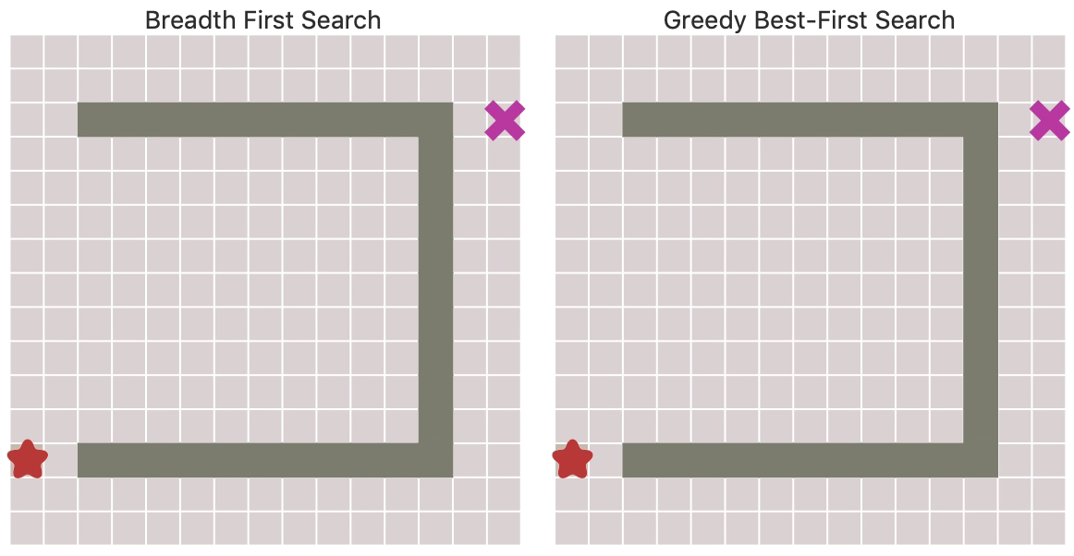
BFS v. Greedy Best-First Search
https://www.redblobgames.com/pathfinding/a-star/introduction.html
Notes:
. Slide 5: BFS v. Greedy Best-First Search
Now that we've covered the basics of Greedy Best-First Search, let's compare it with Breadth-First Search (BFS) to better understand their differences.
In the animation on the slide, we can see BFS and Greedy Best-First Search in action, searching for a path from the start node to the goal node in a grid-based environment.
BFS (left side):
Expands nodes in a breadth-first manner, exploring all neighbors before moving to the next level.
Guarantees finding the shortest path (if one exists) but may explore many unnecessary nodes.
Explores a large portion of the grid (light purple squares) before reaching the goal.
Greedy Best-First Search (right side):
Uses a heuristic function (in this case, the Manhattan distance) to estimate the distance from each node to the goal.
Always expands the node that appears to be closest to the goal, based on the heuristic.
Quickly moves towards the goal node, seemingly ignoring other directions.
Expands nodes estimated to be closer to the goal (darker purple squares), leaving many unexplored nodes (light gray squares) behind.
While Greedy Best-First Search reaches the goal faster than BFS in this instance, it's important to note that it does not guarantee finding the shortest path. In fact, we can see that the path found by Greedy Best-First Search (darker purple squares) is longer than the shortest path found by BFS.
This comparison highlights the key differences between uninformed search (like BFS) and informed search (like Greedy Best-First Search):
BFS systematically explores the search space and guarantees finding the shortest path but can be inefficient in large search spaces.
Greedy Best-First Search uses a heuristic to guide its search, which can lead to faster solutions but doesn't guarantee optimality.

Slide 44
Properties of greedy best-first search
Complete?
No – can get stuck in loops,
e.g., Iridonia → Polis Massa→ Iridonia → Polis Massa →…
Notes:
. In the previous slide, we discussed the optimality of Greedy Best-First Search and saw that it is not guaranteed to find the shortest path. Now, let's take a closer look at its completeness property.
Complete?
No - can get stuck in loops
e.g., Iridonia → Polis Massa→ Iridonia → Polis Massa → ...
As the example on the slide shows, Greedy Best-First Search can get stuck in loops when using tree search. In this case, it keeps alternating between Iridonia and Polis Massa, never reaching the goal planet Kessel.
This happens because tree search treats each node as a separate state, even if it has been visited before. As a result, the algorithm may keep expanding the same nodes repeatedly, leading to infinite loops.
To avoid this issue, we can use graph search instead of tree search. In graph search, we keep track of the nodes that have already been visited and avoid expanding them again. This ensures that the algorithm will eventually terminate, even if it may not find the optimal path.

Slide 45
Informed Search
Notes:
videos:
-
authors: BBC
url: https://www.youtube.com/watch?v=KF6sLCeBj0s
title: Deep Blue vs Kasparov&colon; How a computer beat best chess player in the world
length: 4 minutes

Slide 46
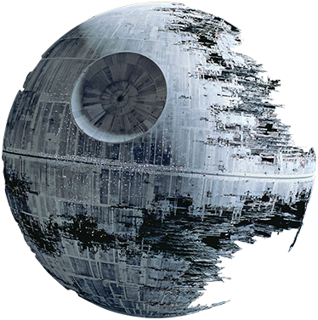
A* search
“That’s no moon…”
AIMA 3.5
“That’s a star…”
Notes:
In this lecture I will introduce A* search, which is the best-known of the best-first search algorithms. When I was an undergraduate, I took an artificial intelligence class from Nils Nilsson, the inventor of A*. He shared a fun anecdote about why it's called A*: "A" stands for "algorithm", and the star is because it's a neat algorithm - it gets a star! A* has some very cool properties that allow it to behave not only optimally – by returning the lowest cost path solution first – but also to arrive at that best solution faster than the uninformed search algorithms that we looked at previously. The key idea is that we want to prune out paths that are already known to be expensive while still expanding the most promising paths first.

Slide 47
A* search
Best-known form of best-first search.
Key Idea: avoid expanding paths that are already expensive but expand most promising first.
Simple idea: f(n)=g(n) + h(n)
g(n) the actual cost (so far) to reach the node
h(n) estimated cost to get from the node to the goal
f(n) estimated total cost of path through n to goal
Implementation: Frontier queue as priority queue by increasing f(n) (as expected…)
Notes:
So far, we've looked at best-first search algorithms where the evaluation function f(n) equals either the path cost g(n) or the heuristic cost h(n). When f(n) = g(n), we're doing uniform-cost search When f(n) = h(n), it's greedy best-first search But when f(n) = g(n) + h(n), we're doing A* search
However, for it to be a true A* search, the heuristic function h(n) needs to have a special property called admissibility.
As with other best-first search algorithms, we implement the frontier as a priority queue and expand nodes with the minimum f-cost.

Slide 48
Key concept: Admissible heuristics
A heuristic h(n) is admissible if it never overestimates the cost to reach the goal; i.e. it is optimistic
Formally:∀n, n a node:
h(n) ≤ h*(n) where h*(n) is the true cost from n
h(n) ≥ 0 so h(G)=0 for any goal G.
Example: h_{SLD}(n) never overestimates the actual road distance
Theorem: If h(n) is admissible, A* using Tree Search is optimal
Notes:
The key property the heuristic function needs for A* to work is admissibility. An admissible heuristic never overestimates the true cost to reach the goal from any node - in other words, it's optimistic.
Formally, we can say that for any node n, h(n) must be less than or equal to h*(n), where h* is the true cost to the goal. Additionally, since there's no actual cost from a goal node to itself, h(n) must be greater than or equal to 0, and h(goal) = 0.
An example of an admissible heuristic is straight-line distance in a map navigation task. It never overestimates the actual road distance to the goal.
If we have an admissible heuristic, A* search is guaranteed to find the optimal path to the goal.

Slide 49
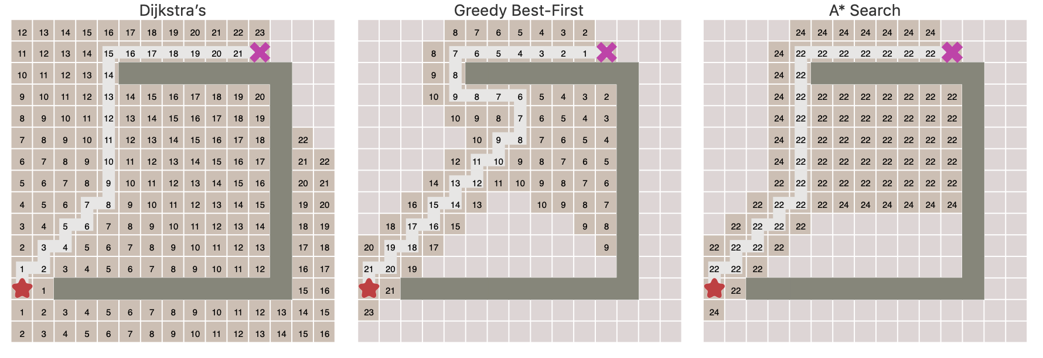
A* is optimal with admissible heuristic
Uniform Cost Search
Greedy Best-First Search
A* Search
https://www.redblobgames.com/pathfinding/a-star/introduction.html
Notes:
This illustration from Red Blob Games shows the difference between uniform-cost search, greedy best-first search, and A* search.
The numbers indicate the order in which nodes are expanded. Notice how greedy search is not optimal, as it never explores the true lowest-cost path. In contrast, A* with an admissible heuristic finds the shortest path to the goal, though it does expand more nodes than greedy search.
The idea behind admissibility is that h(n) represents an optimistic estimate of the cost to the goal. It may slow down bad plans, but it will never outweigh the true cost. If h(n) is inadmissible and overestimates, promising paths might get pushed too far down the priority queue to be expanded in time. As long as the heuristic underestimates the true cost, we're guaranteed to expand nodes in the optimal order and find the shortest path first.

Slide 50
Onderon
71
Coruscant
Polis Massa
151
87
Iridonia
75
140
Starkiller Base
Alderaan
92
99
Endor
118
80
Vandor-1
Tatooine
Ryloth
142
111
Naboo
211
Lotho Minor
97
98
70
146
85
Hoth
101
Mandalore
Bespin
75
86
Dagobah
138
Kessel
90
120
Zygerria
Fondor
Geonosis

Slide 51
A* search example
Alderaan
Initial State: Alderaan Goal State: Kessel
Frontier queue:
Planet | SLD |  | Planet | SLD
Alderaan | 366 |  | Lotho Minor | 244
Bespin | 80 |  | Mandalore | 241
Coruscant | 374 |  | Naboo | 100
Dagobah | 242 |  | Onderon | 380
Endor | 176 |  | Polis Massa | 234
Fondor | 161 |  | Ryloth | 193
Geonosis | 77 |  | Starkiller Base | 253
Hoth | 151 |  | Tatooine | 329
Iridonia | 226 |  | Vandor-1 | 199
Kessel | 0 |  | Zygerria | 160
Alderon 366 = 0 + 366
Notes:
Let's walk through an example of A* search to find the shortest path from Alderaan to Kessel in our Star Wars universe map.
We start with Alderaan in the frontier queue. Its f-cost is f(Alderaan) = g(Alderaan) + h(Alderaan) = 0 + 366 = 366, where g is the path cost so far and h is the straight-line distance heuristic.
The table on the right shows the straight-line distances from each planet to Kessel, our goal state.

Slide 52
A* search example
Alderaan
Initial State: Alderaan Goal State: Kessel
Starkiller Base
Tatooine
Coruscant
f(n) = g(n) + h(n)
Frontier queue:
Planet | SLD |  | Planet | SLD
Alderaan | 366 |  | Lotho Minor | 244
Bespin | 80 |  | Mandalore | 241
Coruscant | 374 |  | Naboo | 100
Dagobah | 242 |  | Onderon | 380
Endor | 176 |  | Polis Massa | 234
Fondor | 161 |  | Ryloth | 193
Geonosis | 77 |  | Starkiller Base | 253
Hoth | 151 |  | Tatooine | 329
Iridonia | 226 |  | Vandor-1 | 199
Kessel | 0 |  | Zygerria | 160
Starkiller Base 393 = 140 + 253
Tatooine 447 = 118 + 329
Coruscant 449 = 75 + 374
Notes:
We expand Alderaan and add its neighbors to the frontier:
Starkiller base has path cost g of 140 traveling from Alderan to StarKiller base + a heuristic SLD cost of 253 to get from StarKiller to Kessel (according to the table), for a total f cost of 393
Tatooine has f = 447, with a path cost of 118 + hueristic cost ot get to the goal of 329
Coruscant has f = 449, with path cost of 75 + heursitic cost of 374
We're doing graph search, not tree search, so we need to be careful not to expand the same state twice along different paths.

Slide 53
A* search example
Alderaan
Initial State: Alderaan Goal State: Kessel
Starkiller Base
Tatooine
Coruscant
Ryloth
Onderon
Endor
Alderaan
Frontier queue:
Planet | SLD |  | Planet | SLD
Alderaan | 366 |  | Lotho Minor | 244
Bespin | 80 |  | Mandalore | 241
Coruscant | 374 |  | Naboo | 100
Dagobah | 242 |  | Onderon | 380
Endor | 176 |  | Polis Massa | 234
Fondor | 161 |  | Ryloth | 193
Geonosis | 77 |  | Starkiller Base | 253
Hoth | 151 |  | Tatooine | 329
Iridonia | 226 |  | Vandor-1 | 199
Kessel | 0 |  | Zygerria | 160
Are we doing graph search or tree search?
Tatooine 447 = 118 + 329
Coruscant 449 = 75 + 374
Alderaan 646 = 280 + 366
Onderon 526 = 146 + 380
Endor 415 = 239 + 176
Ryloth 413 = 220 + 193

Slide 54
Graph search versus tree search
What is the difference between graph search and tree search?
PollEv.com​/ccb

Slide 55
A* search example
Alderaan
Initial State: Alderaan Goal State: Kessel
Starkiller Base
Tatooine
Coruscant
Sort queue by f(n).
f(n) = g(n) + h(n)
Ryloth
Onderon
Endor
Alderaan
Frontier queue:
Planet | SLD |  | Planet | SLD
Alderaan | 366 |  | Lotho Minor | 244
Bespin | 80 |  | Mandalore | 241
Coruscant | 374 |  | Naboo | 100
Dagobah | 242 |  | Onderon | 380
Endor | 176 |  | Polis Massa | 234
Fondor | 161 |  | Ryloth | 193
Geonosis | 77 |  | Starkiller Base | 253
Hoth | 151 |  | Tatooine | 329
Iridonia | 226 |  | Vandor-1 | 199
Kessel | 0 |  | Zygerria | 160
Ryloth 413 = 220 + 193
Endor 415 = 239 + 176
Tatooine 447 = 118 + 329
Coruscant 449 = 75 + 374
Onderon 526 = 146 + 380
Alderaan 646 = 280 + 366

Slide 56
A* search example
Alderaan
Initial State: Alderaan Goal State: Kessel
Starkiller Base
Tatooine
Coruscant
Ryloth
Onderon
Endor
Alderaan
Frontier queue:
Planet | SLD |  | Planet | SLD
Alderaan | 366 |  | Lotho Minor | 244
Bespin | 80 |  | Mandalore | 241
Coruscant | 374 |  | Naboo | 100
Dagobah | 242 |  | Onderon | 380
Endor | 176 |  | Polis Massa | 234
Fondor | 161 |  | Ryloth | 193
Geonosis | 77 |  | Starkiller Base | 253
Hoth | 151 |  | Tatooine | 329
Iridonia | 226 |  | Vandor-1 | 199
Kessel | 0 |  | Zygerria | 160
Starkiller Base
Naboo
Endor 415 = 239 + 176
Tatooine 447 = 118 + 329
Coruscant 449 = 75 + 374
Onderon 526 = 146 + 380
Alderaan 646 = 280 + 366
Starkiller Base 532 = 300 + 253
Naboo 417 = 317 + 100

Slide 57
A* search example
Alderaan
Initial State: Alderaan Goal State: Kessel
Starkiller Base
Tatooine
Coruscant
Ryloth
Onderon
Endor
Alderaan
Frontier queue:
Planet | SLD |  | Planet | SLD
Alderaan | 366 |  | Lotho Minor | 244
Bespin | 80 |  | Mandalore | 241
Coruscant | 374 |  | Naboo | 100
Dagobah | 242 |  | Onderon | 380
Endor | 176 |  | Polis Massa | 234
Fondor | 161 |  | Ryloth | 193
Geonosis | 77 |  | Starkiller Base | 253
Hoth | 151 |  | Tatooine | 329
Iridonia | 226 |  | Vandor-1 | 199
Kessel | 0 |  | Zygerria | 160
Starkiller Base
Naboo
Endor 415 = 239 + 176
Naboo 417 = 317 + 100
Tatooine 447 = 118 + 329
Coruscant 449 = 75 + 374
Onderon 526 = 146 + 380
Starkiller Base 532 = 300 + 253
Alderaan 646 = 280 + 366

Slide 58
A* search example
Alderaan
Initial State: Alderaan Goal State: Kessel
Starkiller Base
Tatooine
Coruscant
No, we apply the goal test to the top of the queue.
Ryloth
Onderon
Endor
Alderaan
Frontier queue:
Planet | SLD |  | Planet | SLD
Alderaan | 366 |  | Lotho Minor | 244
Bespin | 80 |  | Mandalore | 241
Coruscant | 374 |  | Naboo | 100
Dagobah | 242 |  | Onderon | 380
Endor | 176 |  | Polis Massa | 234
Fondor | 161 |  | Ryloth | 193
Geonosis | 77 |  | Starkiller Base | 253
Hoth | 151 |  | Tatooine | 329
Iridonia | 226 |  | Vandor-1 | 199
Kessel | 0 |  | Zygerria | 160
Starkiller Base
Naboo
Starkiller Base
Kessel
Naboo 417 = 317 + 100
Tatooine 447 = 118 + 329
Coruscant 449 = 75 + 374
Onderon 526 = 146 + 380
Starkiller Base 532 = 300 + 253
Do we apply the goal test to the children like in BFS?
Alderaan 646 = 280 + 366
Starkiller Base 591 = 338 + 253
Kessel 450 = 450 + 0

Slide 59
A* search example
Alderaan
Initial State: Alderaan Goal State: Kessel
Starkiller Base
Tatooine
Coruscant
Kessel is not yet at top of the queue, so there may be a shorter path...
Ryloth
Onderon
Endor
Alderaan
Frontier queue:
Planet | SLD |  | Planet | SLD
Alderaan | 366 |  | Lotho Minor | 244
Bespin | 80 |  | Mandalore | 241
Coruscant | 374 |  | Naboo | 100
Dagobah | 242 |  | Onderon | 380
Endor | 176 |  | Polis Massa | 234
Fondor | 161 |  | Ryloth | 193
Geonosis | 77 |  | Starkiller Base | 253
Hoth | 151 |  | Tatooine | 329
Iridonia | 226 |  | Vandor-1 | 199
Kessel | 0 |  | Zygerria | 160
Starkiller Base
Naboo
Starkiller Base
Kessel
Naboo 417 = 317 + 100
Tatooine 447 = 118 + 329
Coruscant 449 = 75 + 374
Kessel 450 = 450 + 0
Onderon 526 = 146 + 380
Starkiller Base 532 = 300 + 253
Starkiller Base 591 = 338 + 253
Alderaan 646 = 280 + 366

Slide 60
A* search example
Alderaan
Initial State: Alderaan Goal State: Kessel
Starkiller Base
Tatooine
Coruscant
Ryloth
Onderon
Endor
Alderaan
Frontier queue:
Planet | SLD |  | Planet | SLD
Alderaan | 366 |  | Lotho Minor | 244
Bespin | 80 |  | Mandalore | 241
Coruscant | 374 |  | Naboo | 100
Dagobah | 242 |  | Onderon | 380
Endor | 176 |  | Polis Massa | 234
Fondor | 161 |  | Ryloth | 193
Geonosis | 77 |  | Starkiller Base | 253
Hoth | 151 |  | Tatooine | 329
Iridonia | 226 |  | Vandor-1 | 199
Kessel | 0 |  | Zygerria | 160
Starkiller Base
Naboo
Starkiller Base
Kessel
Naboo 417 = 317 + 100
Tatooine 447 = 118 + 329
Coruscant 449 = 75 + 374
Kessel 450 = 450 + 0
Onderon 526 = 146 + 380
Starkiller Base 532 = 300 + 253
Starkiller Base 591 = 338 + 253
Alderaan 646 = 280 + 366

Slide 61
A* search example
Alderaan
Initial State: Alderaan Goal State: Kessel
Starkiller Base
Tatooine
Coruscant
Ryloth
Onderon
Endor
Alderaan
Frontier queue:
Planet | SLD |  | Planet | SLD
Alderaan | 366 |  | Lotho Minor | 244
Bespin | 80 |  | Mandalore | 241
Coruscant | 374 |  | Naboo | 100
Dagobah | 242 |  | Onderon | 380
Endor | 176 |  | Polis Massa | 234
Fondor | 161 |  | Ryloth | 193
Geonosis | 77 |  | Starkiller Base | 253
Hoth | 151 |  | Tatooine | 329
Iridonia | 226 |  | Vandor-1 | 199
Kessel | 0 |  | Zygerria | 160
Starkiller Base
Naboo
Starkiller Base
Kessel
Tatooine 447 = 118 + 329
Coruscant 449 = 75 + 374
Kessel 450 = 450 + 0
Onderon 526 = 146 + 380
Kessel
Starkiller Base 532 = 300 + 253
Ryloth
Starkiller Base 591 = 338 + 253
Alderaan 646 = 280 + 366
Ryloth 607 = 414 + 193
Kessel 418 = 418 + 0

Slide 62
A* search example
Alderaan
Initial State: Alderaan Goal State: Kessel
Starkiller Base
Tatooine
Coruscant
Passes the goal test, so this is the shortest path to Kessel!
Ryloth
Onderon
Endor
Alderaan
Frontier queue:
Planet | SLD |  | Planet | SLD
Alderaan | 366 |  | Lotho Minor | 244
Bespin | 80 |  | Mandalore | 241
Coruscant | 374 |  | Naboo | 100
Dagobah | 242 |  | Onderon | 380
Endor | 176 |  | Polis Massa | 234
Fondor | 161 |  | Ryloth | 193
Geonosis | 77 |  | Starkiller Base | 253
Hoth | 151 |  | Tatooine | 329
Iridonia | 226 |  | Vandor-1 | 199
Kessel | 0 |  | Zygerria | 160
Starkiller Base
Naboo
Starkiller Base
Kessel
Kessel 418 = 418 + 0
Tatooine 447 = 118 + 329
Coruscant 449 = 75 + 374
Kessel 450 = 450 + 0
Ryloth
Kessel
Onderon 526 = 146 + 380
Starkiller Base 532 = 300 + 253
Starkiller Base 591 = 338 + 253
Ryloth 607 = 414 + 193
Alderaan 646 = 280 + 366

Slide 63


Idea: Admissibility
Inadmissible (pessimistic) heuristics break optimality by trapping good plans on the frontier
Admissible (optimistic) heuristics slow down bad plans but never outweigh true costs
Slide credit: Dan Klein and Pieter Abbeel
http://ai.berkeley.edu
Notes:
The key to A*'s optimality lies in the idea of admissibility. Admissible heuristics are optimistic - they never overestimate the true cost to the goal.
Inadmissible or pessimistic heuristics, on the other hand, can break optimality by causing good plans to get stuck on the frontier. If a heuristic overestimates the cost to the goal, A* might think a suboptimal path is better than it really is.
In contrast, admissible heuristics slow down bad plans by adding to their f-cost, but never enough to outweigh the true path cost. So even if A* pursues some suboptimal paths, it will always find the optimal one first.

Slide 64
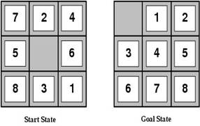
Heuristic functions
For the 8-puzzle
Avg. solution cost is about 22 steps
Search cost for BFS is about 176,000 nodes expanded
A good heuristic function can reduce the search process
Notes:
. Let's look at some heuristics for the 8-puzzle. The average optimal solution is about 22 moves, so a good heuristic can significantly reduce the search space.
Two common admissible heuristics are:
h_oop(n): The number of tiles out of place. Here that's 8.
h_md(n): The sum of Manhattan distances from each tile's current position to its goal position. Here that's 3+1+2+2+2+3+3+2 = 18.
Both are admissible because they underestimate the true number of moves needed. But which is better?

Slide 65
Example Admissible heuristics
For the 8-puzzle:
h_{oop}(n) = number of out of place tiles
h_{md}(n) = total Manhattan distance (i.e., # of moves from desired location of each tile)
h_{oop}(S) = 8
h_{md}(S) = 3+1+2+2+2+3+3+2 = 18
BFS expands about 176,000 nodes, A* with h_{oop} expands about 23,000
A* with h_{md} expands about 2,500
Notes:
Let's look at some heuristics for the 8-puzzle. The average optimal solution is about 22 moves, so a good heuristic can significantly reduce the search space.
Two common admissible heuristics are:
h_oop(n): The number of tiles out of place. Here that's 8.
h_md(n): The sum of Manhattan distances from each tile's current position to its goal position. Here that's 3+1+2+2+2+3+3+2 = 18.
Both are admissible because they underestimate the true number of moves needed. But which is better?

Slide 66
Relaxed problems
A problem with fewer restrictions on the actions than the original is called a relaxed problem
The cost of an optimal solution to a relaxed problem is an admissible heuristic for the original problem
If the rules of the 8-puzzle are relaxed so that a tile can move anywhere, then h_{oop}(n) gives the shortest solution
If the rules are relaxed so that a tile can move to any adjacent square, then h_{md}(n) gives the shortest solution
Notes:
To find admissible heuristics, a useful technique is to define relaxed problems. A relaxed problem has fewer restrictions on its actions compared to the original problem.
The cost of an optimal solution to a relaxed problem is guaranteed to be an admissible heuristic for the original problem. With fewer restrictions, you can always get to the goal at least as easily as in the original problem.
For the 8-puzzle, if we allow a tile to move anywhere, then h_oop is exactly the relaxed solution cost. If we relax the rules to allow a tile to move to any adjacent square, then h_md is the relaxed solution cost.

Slide 67
Defining Heuristics: h(n)
Cost of an exact solution to a relaxed problem (fewer restrictions on operator)
Constraints on Full Problem:
A tile can move from square A to square B if A is adjacent to B and B is blank.
Constraints on relaxed problems:
A tile can move from square A to square B if A is adjacent to B. (h_{md})
A tile can move from square A to square B if B is blank.
A tile can move from square A to square B. (h_{oop})
Notes:
. In general, we can define heuristics by solving relaxed versions of our problem.
In the 8-puzzle, the two constraints are:
A tile can only move to an adjacent square
It can only move to the blank square
By dropping one or both constraints, we get relaxed problems whose optimal solutions are exactly h_md and h_oop.

Slide 68
Dominance: A metric on better heuristics
If h₂(n) ≥ h₁(n) for all n (both admissible)
then h₂ dominates h₁
So h₂ is optimistic, but more accurate than h₁
h₂ is therefore better for search
Notice: h_{md} dominates h_{oop}
Typical search costs (average number of nodes expanded):
d=12 Iterative Deepening Search = 3,644,035 nodes A*(h_{oop}) = 227 nodes, A*(h_{md}) = 73 nodes
d=24 IDS = too many nodes A*(h_{oop}) = 39,135 nodes, A*(h_{md}) = 1,641 nodes
Notes:
. We can compare heuristics using the notion of dominance. If h2(n) is greater than or equal to h1(n) for all states n, and both are admissible, then h2 dominates h1.
A dominant heuristic is more accurate - closer to the true cost without going over. So it's better for search. In the 8-puzzle, h_md dominates h_oop.
The table shows the effect on search costs. For a solution 12 moves deep, A* expands 227 nodes with h_oop but only 73 with h_md. At depth 24, it's 39,135 vs 1,641 nodes - a huge difference!

Slide 69
The best and worst admissible heuristics
h*(n) - the (unachievable) Oracle heuristic
h*(n) = the true distance from the n to goal
h_{we’re here already}(n)= h_{teleportation}(n)=0
Admissible: both yes!!!
h*(n) dominates all other heuristics
h_{teleportation}(n) is dominated by all heuristics
Notes:
.

Slide 70
A* search is Optimal
AIMA 3.5
Notes:
.

Slide 71
A* search
Best-known form of best-first search.
Key Idea: avoid expanding paths that are already expensive, but expand most promising first.
Simple idea: f(n)=g(n) + h(n)
g(n) the actual cost (so far) to reach the node
h(n) estimated cost to get from the node to the goal
f(n) estimated total cost of path through n to goal
Implementation: Frontier queue as priority queue by increasing f(n) (as expected…)
Notes:
.

Slide 72
Key: Admissibility
Inadmissible (pessimistic) heuristics break optimality by pushing good plans too far back on the frontier, which means they may never get expanded.
Admissible (optimistic) heuristics slow down bad plans but never outweigh true costs. That means that the true best plan will always be expanded.
Slide credit: Dan Klein and Pieter Abbeel
http://ai.berkeley.edu
Notes:
.

Slide 73
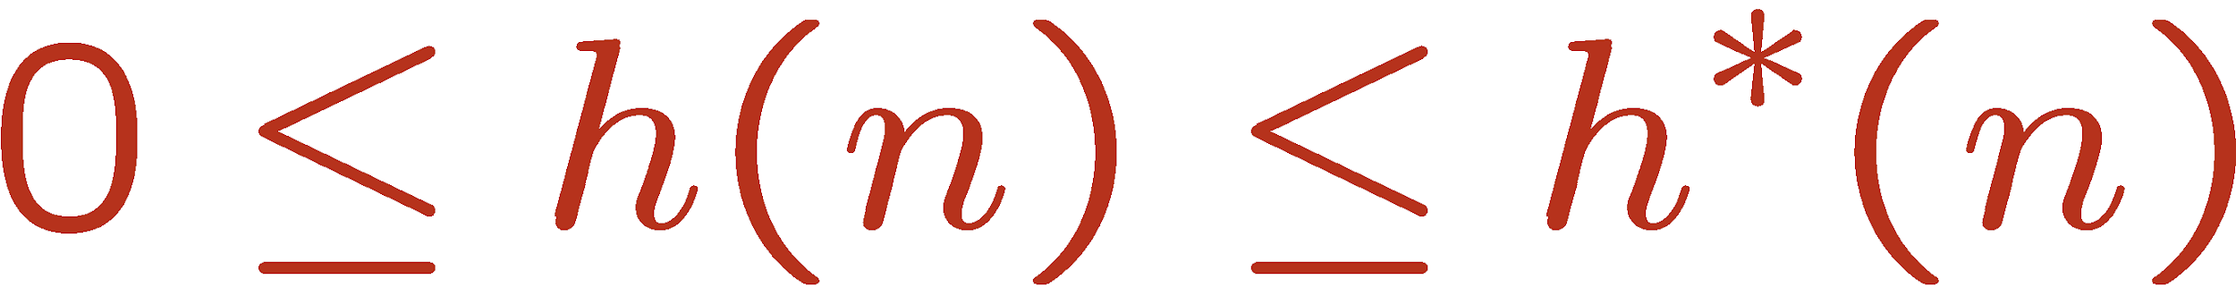


Admissible Heuristics
A heuristic h is admissible (optimistic) if:
where is the true cost to a nearest goal
Is Manhattan Distance admissible?
Coming up with admissible heuristics is most of what’s involved in using A* in practice.
Notes:
.

Slide 74


Optimality of A* Tree Search
Assume:
A is an optimal goal node
B is a suboptimal goal node
h is admissible
Claim:
A will exit the frontier before B
…
Slide credit: Dan Klein and Pieter Abbeel
http://ai.berkeley.edu
Notes:
.

Slide 75


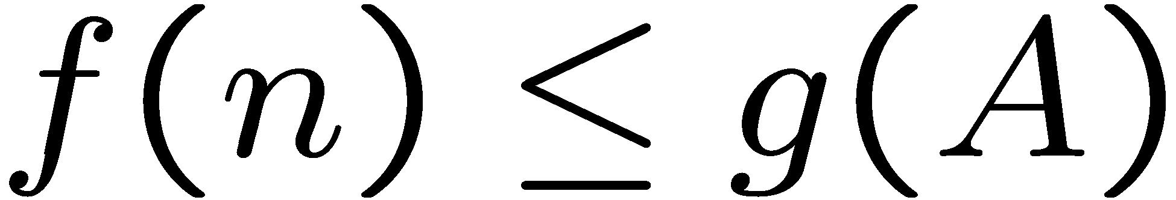
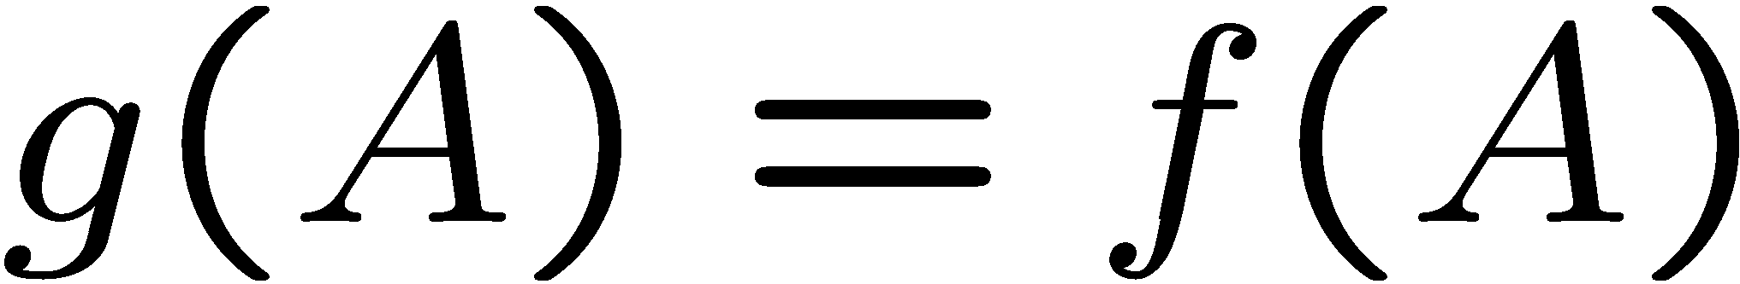
Optimality of A* Tree Search
…
Proof:
Imagine B is on the frontier
Some ancestor n of A is on the frontier, too (maybe A!)
Claim: n will be expanded before B
f(n) is less or equal to f(A)
Definition of f-cost
Admissibility of h
h = 0 at a goal
Slide credit: Dan Klein and Pieter Abbeel
http://ai.berkeley.edu
Notes:
g = path cost, h = admissible heuristic of remaining distance to goal

Slide 76


Optimality of A* Tree Search
…
Proof:
Imagine B is on the frontier
Some ancestor n of A is on the frontier, too (maybe A!)
Claim: n will be expanded before B
f(n) is less or equal to f(A)
f(A) is less than f(B)
B is suboptimal
h = 0 at a goal
Slide credit: Dan Klein and Pieter Abbeel
http://ai.berkeley.edu
Notes:
g = path cost, h = admissible heuristic of remaining distance to goal

Slide 77

Optimality of A* Tree Search
Proof:
Imagine B is on the frontier
Some ancestor n of A is on the frontier, too (maybe A!)
Claim: n will be expanded before B
f(n) is less or equal to f(A)
f(A) is less than f(B)
n expands before B
All ancestors of A expand before B
A expands before B
A* search is optimal
…
Slide credit: Dan Klein and Pieter Abbeel
http://ai.berkeley.edu

Slide 78
Consistent Heuristics
This ensures that A* is optimal in graph search in addition to tree search.
Consistent heuristics are a subset of admissible heuristics, which provide even stronger guarantees. They obey the triangle inequality.
Ryloth
Naboo
150
140
Planet | h1
Ryloth | 150
Zygerria | 5
Naboo | 0
Is h1 admissible? Is h2 admissible?
130
Zygerria
Is h1 consistent? Is h2 consistent?
Planet | h2
Ryloth | 150
Zygerria | 120
Naboo | 0

Slide 79
Properties of A*
Slide credit: Dan Klein and Pieter Abbeel
http://ai.berkeley.edu
Notes:
.

Slide 80
Properties of A*
Uniform-Cost
A*
b
b
…
…
Slide credit: Dan Klein and Pieter Abbeel
http://ai.berkeley.edu
Notes:
.

Slide 81
UCS vs A* Contours
Uniform-cost expands equally in all “directions”
A* expands mainly toward the goal, but does hedge its bets to ensure optimality
Start
Goal
Start
Goal
Slide credit: Dan Klein and Pieter Abbeel
http://ai.berkeley.edu
Notes:
.

Slide 82

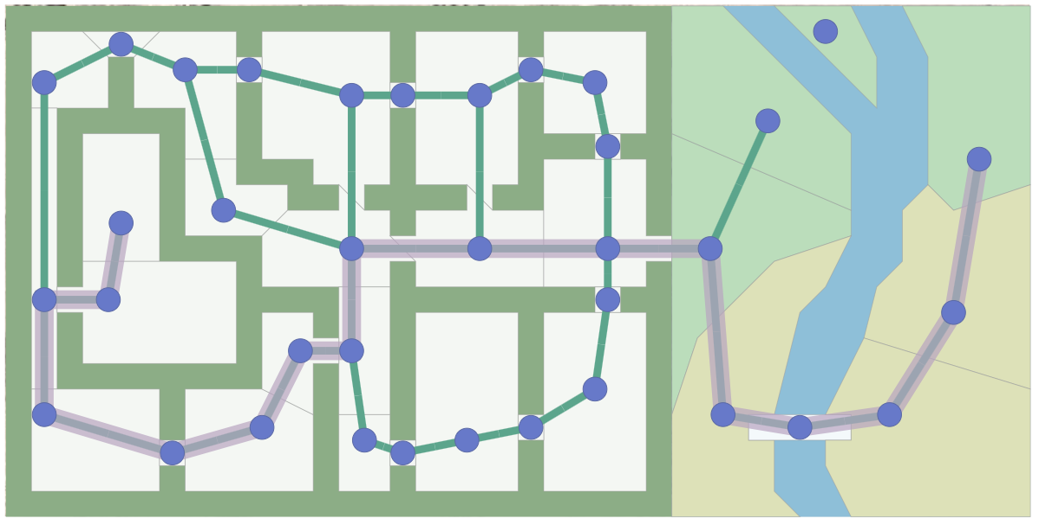
A* Applications
Pathing / routing problems (A* is in your GPS!)
Video games
Robot motion planning
Resource planning problems
…
Notes:
.

Slide 83
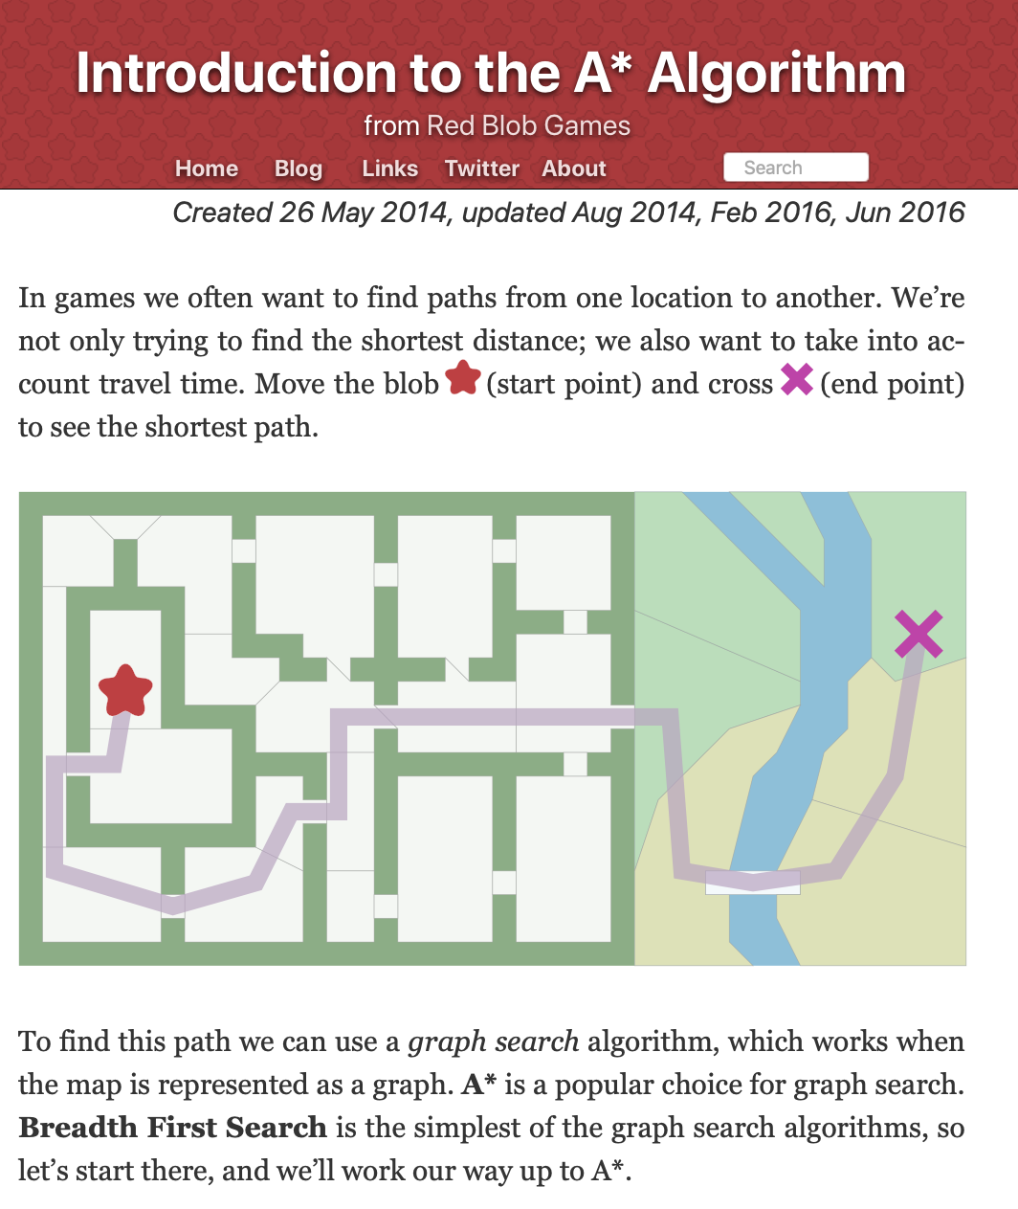
Supplemental Reading
I recommend this A* tutorial by Amit Patel of Red Blob Games
This is not the solution to the HW assignment.
https://www.redblobgames.com/pathfinding/a-star/introduction.html

Slide 84
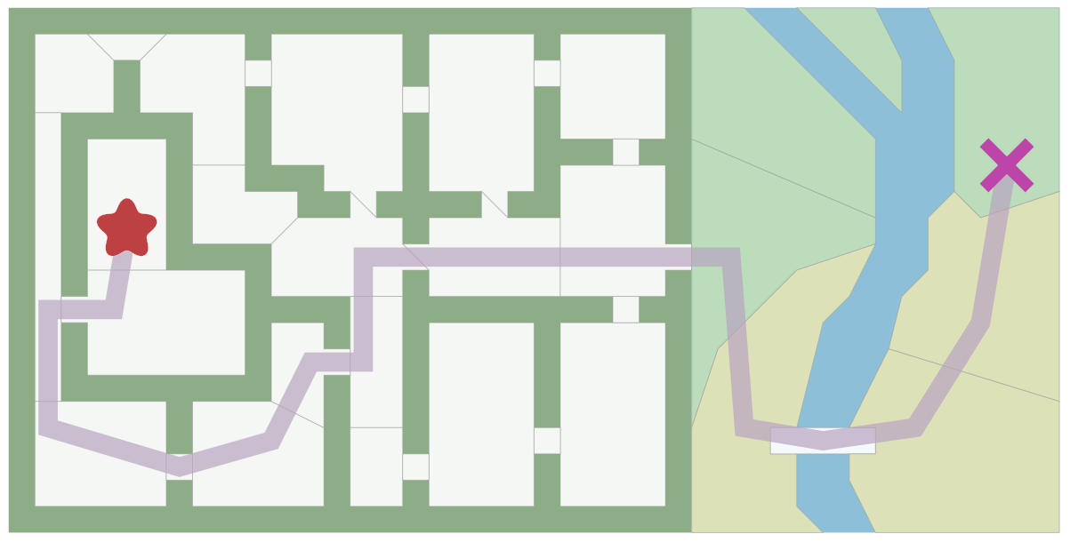
Pathfinding in Games
https://www.redblobgames.com/pathfinding/a-star/introduction.html

Slide 85
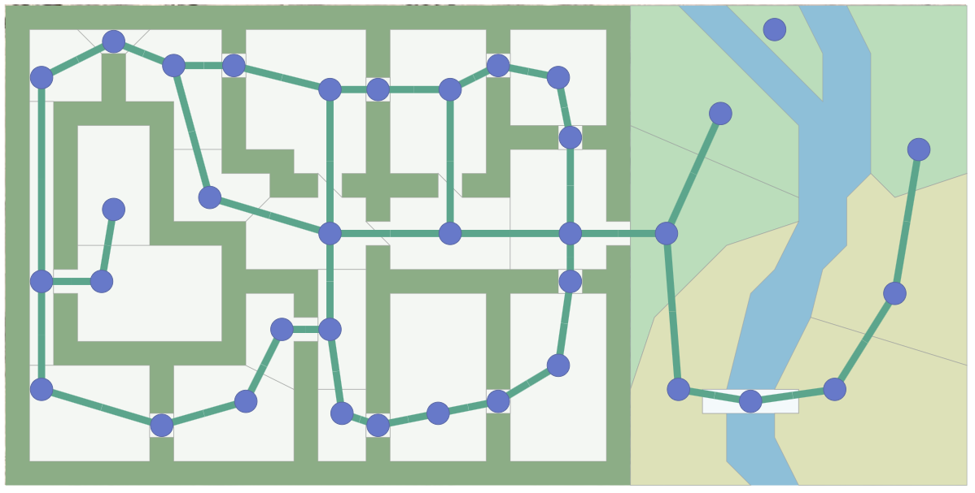

Pathfinding in Games
https://www.redblobgames.com/pathfinding/a-star/introduction.html

Slide 86
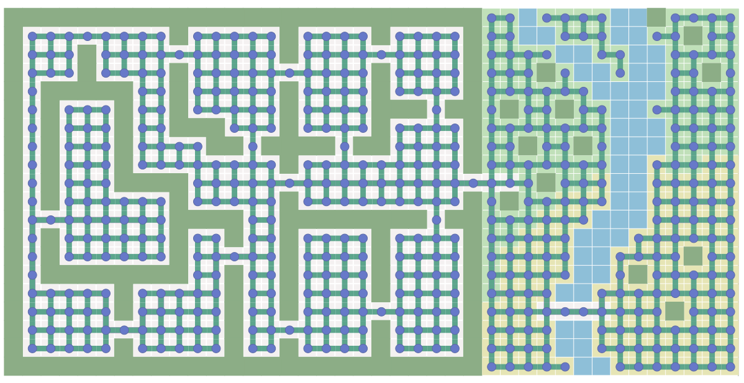

Pathfinding in Games
https://www.redblobgames.com/pathfinding/a-star/introduction.html

Slide 87
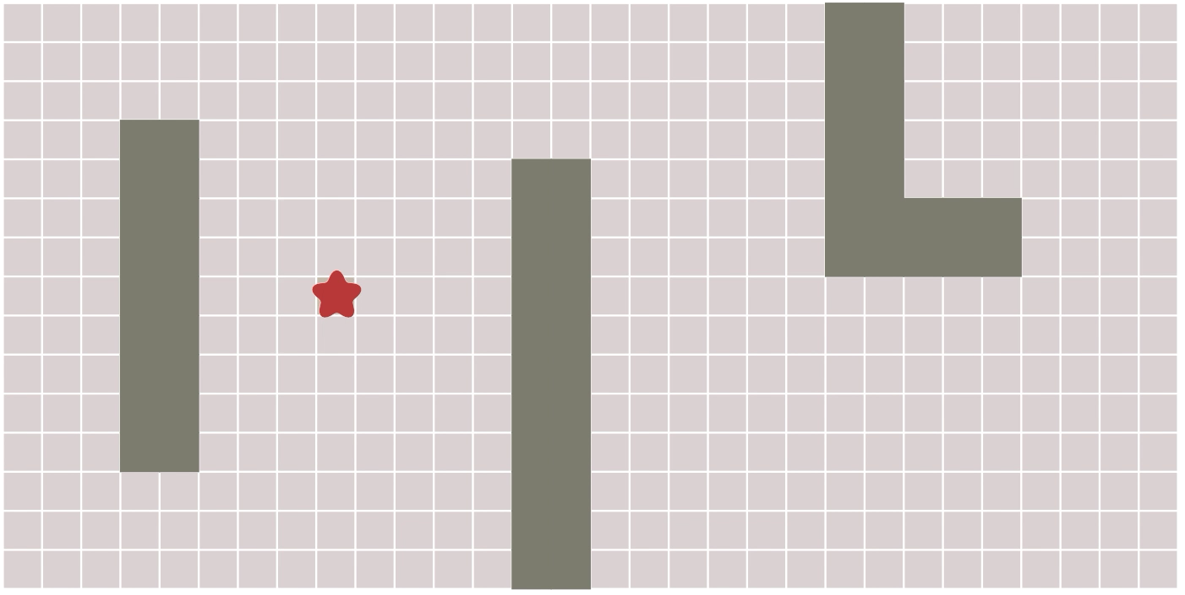
Breadth First Search
https://www.redblobgames.com/pathfinding/a-star/introduction.html

Slide 88
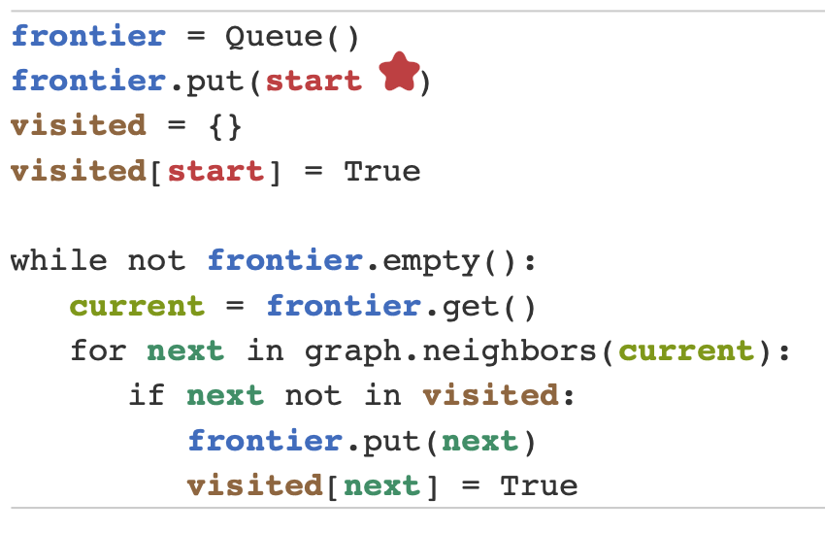
BFS in 10 lines of Python
https://www.redblobgames.com/pathfinding/a-star/introduction.html

Slide 89
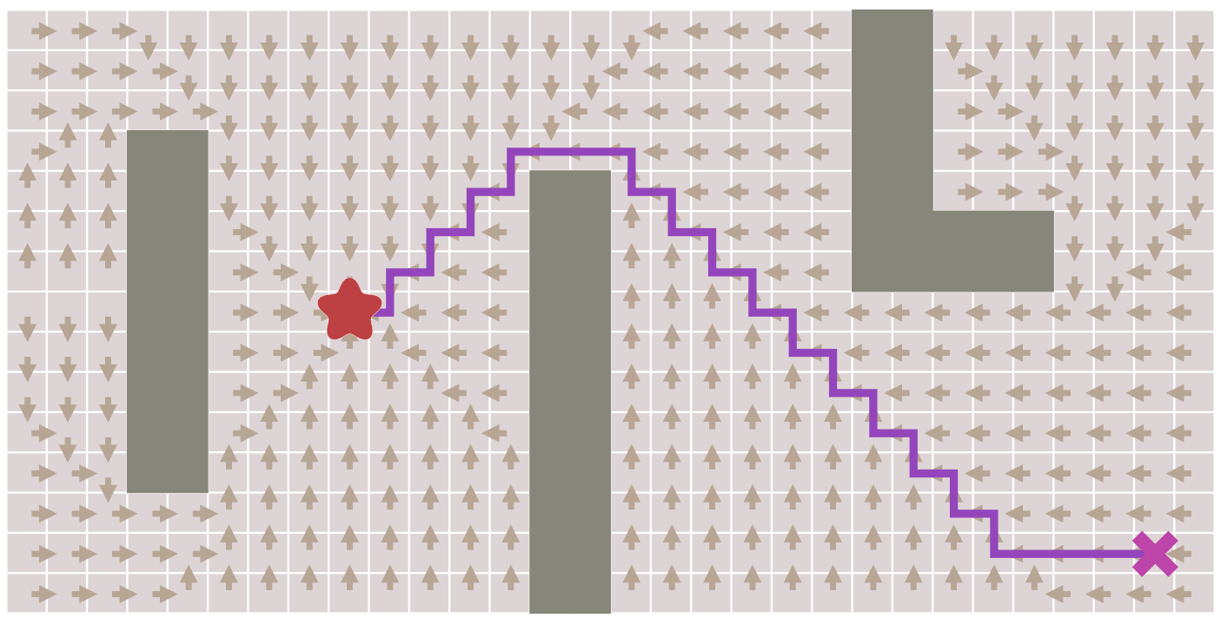
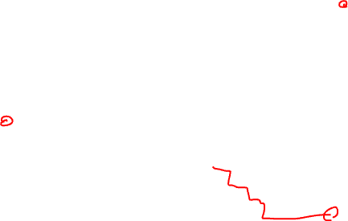
Finding the shortest path
https://www.redblobgames.com/pathfinding/a-star/introduction.html

Slide 90
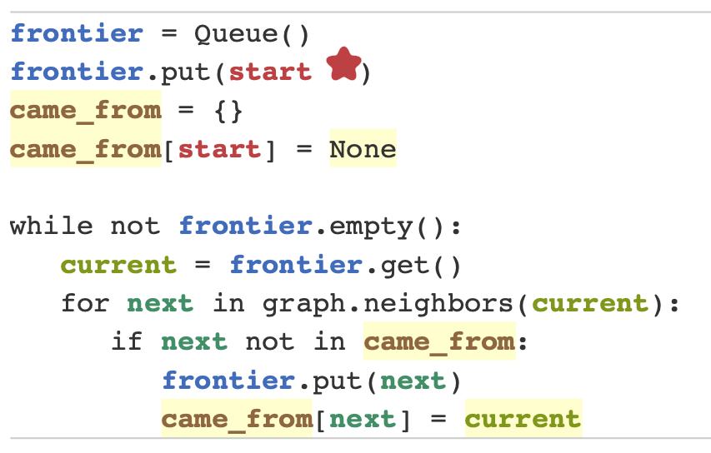
Finding the shortest path
https://www.redblobgames.com/pathfinding/a-star/introduction.html

Slide 91
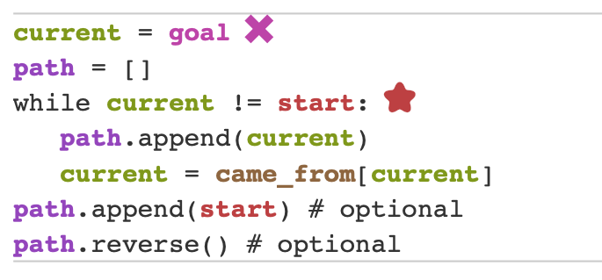
Finding the shortest path

